Slide 1
Azure Managed Image Classification

Slide 2
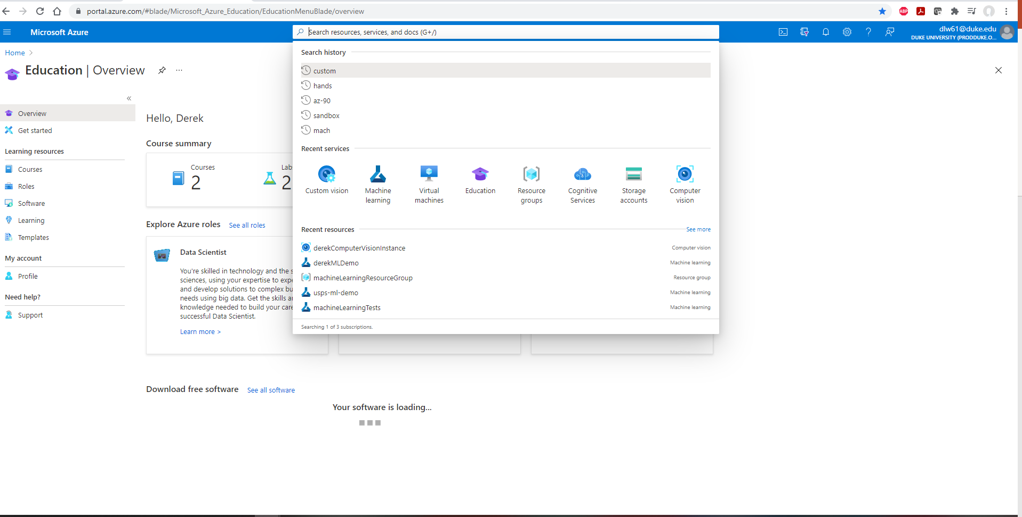
Select Custom Vision

Slide 3
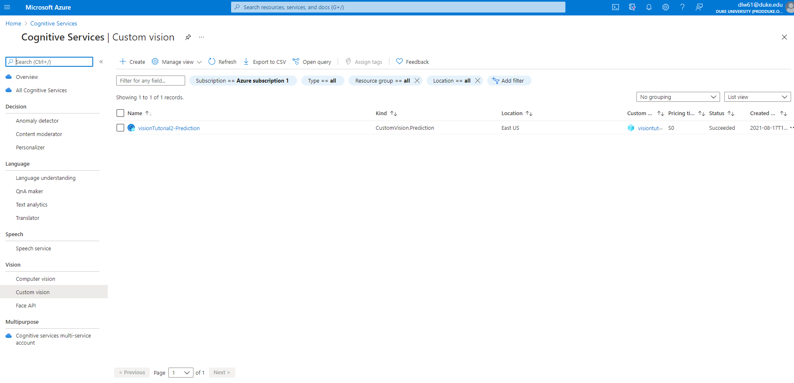
Select Create

Slide 4
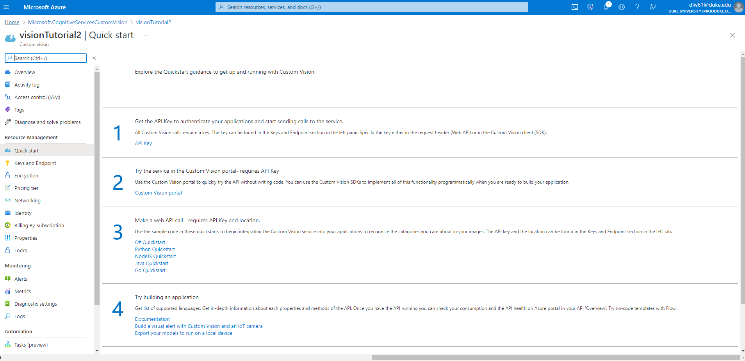
Go to Custom Vision

Slide 5
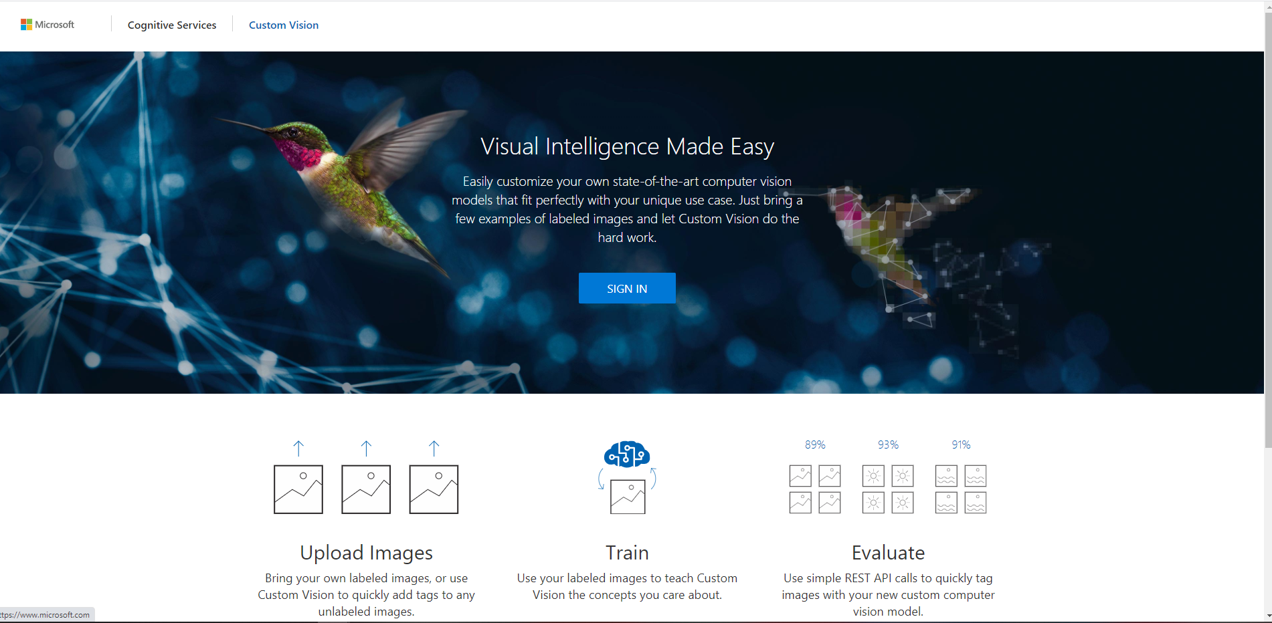

Slide 6
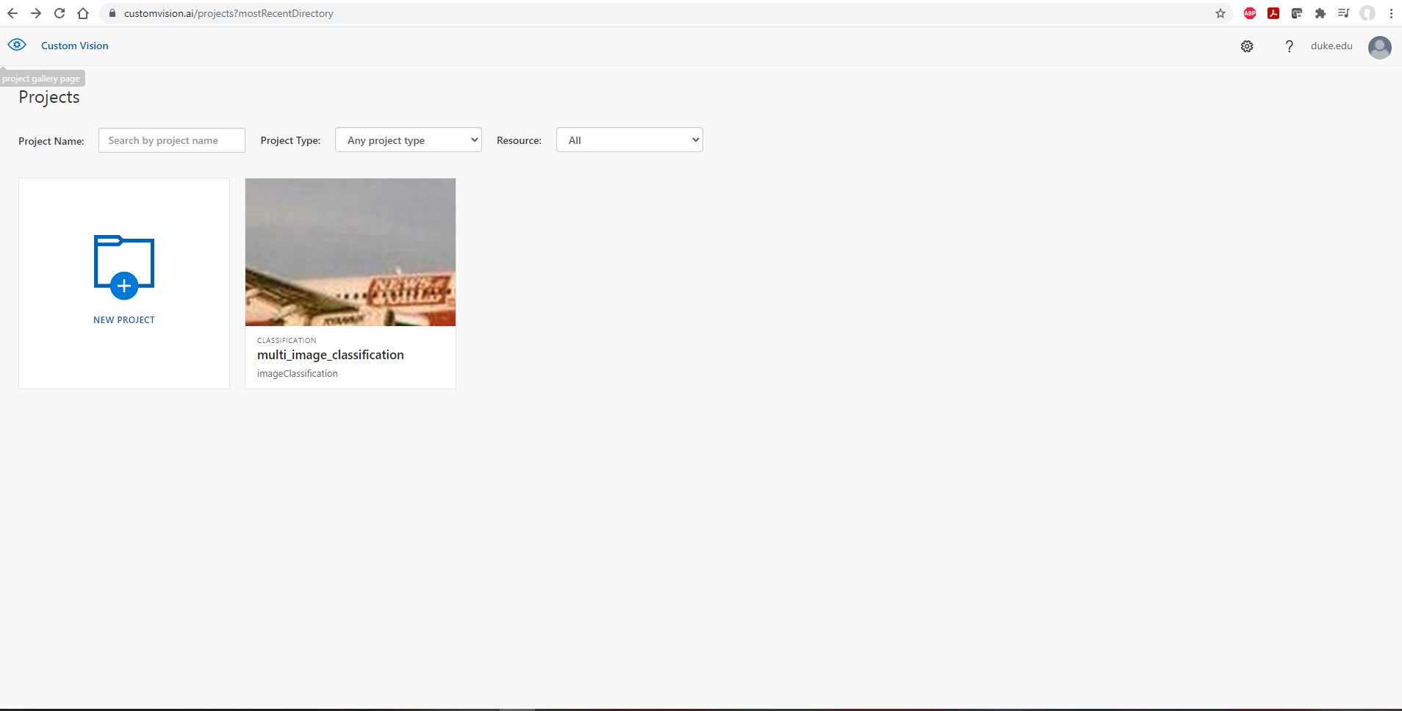
Create or select a project

Slide 7
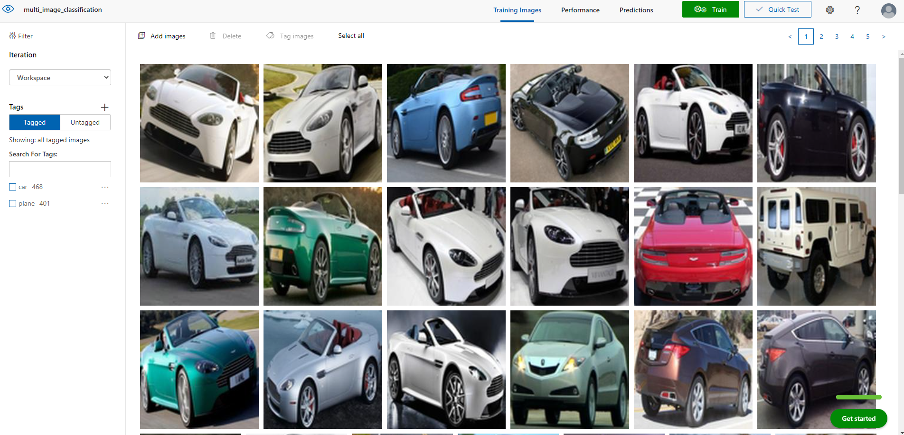
Tag, then train

Slide 8
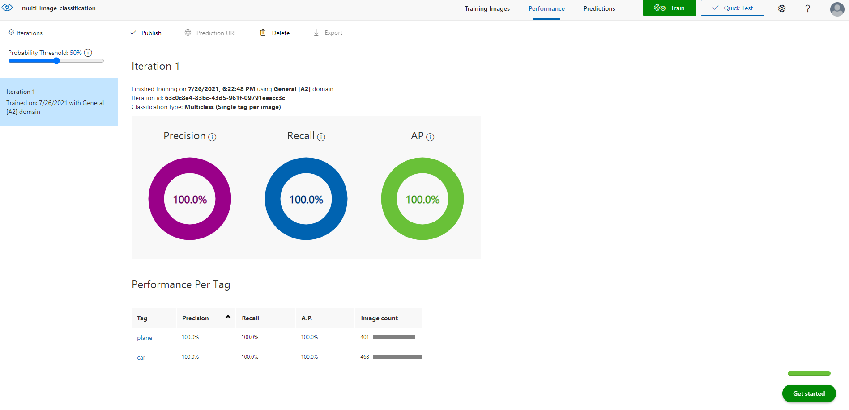
Review performance and deploy

Slide 9
Google Cloud Managed Image Classification

Slide 10
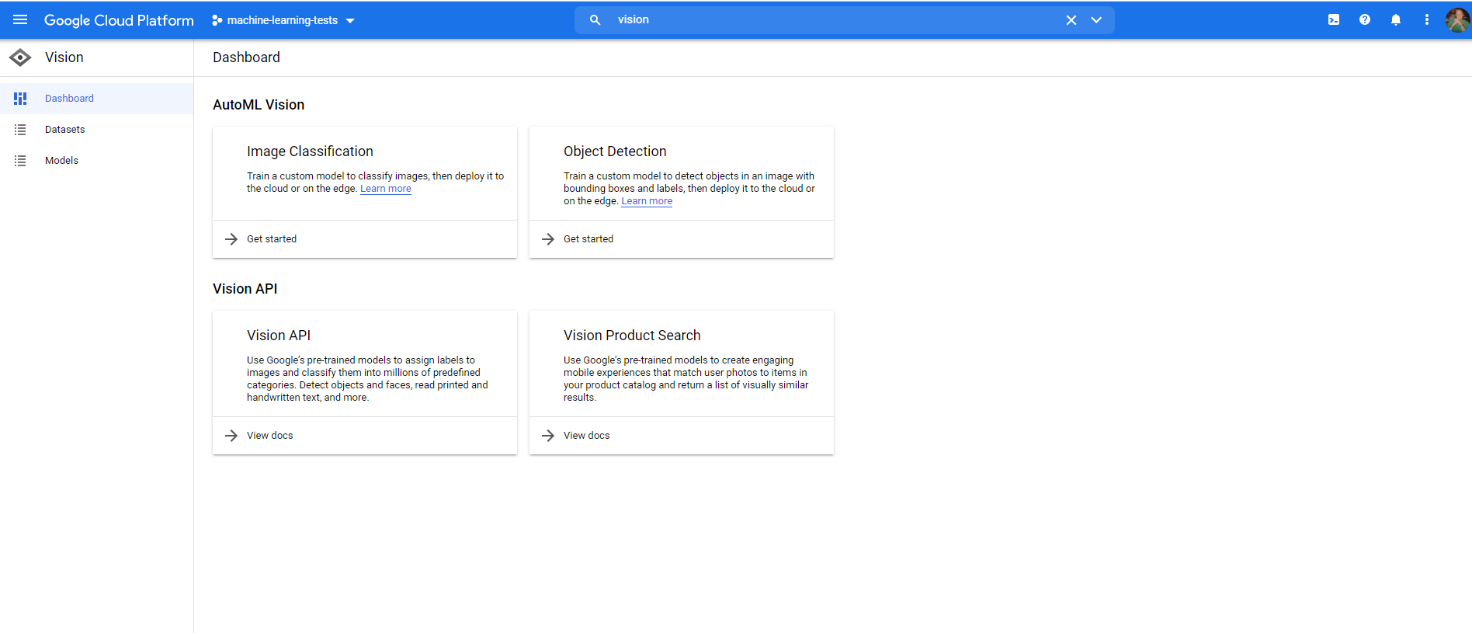
Find Google vision and select image classification

Slide 11
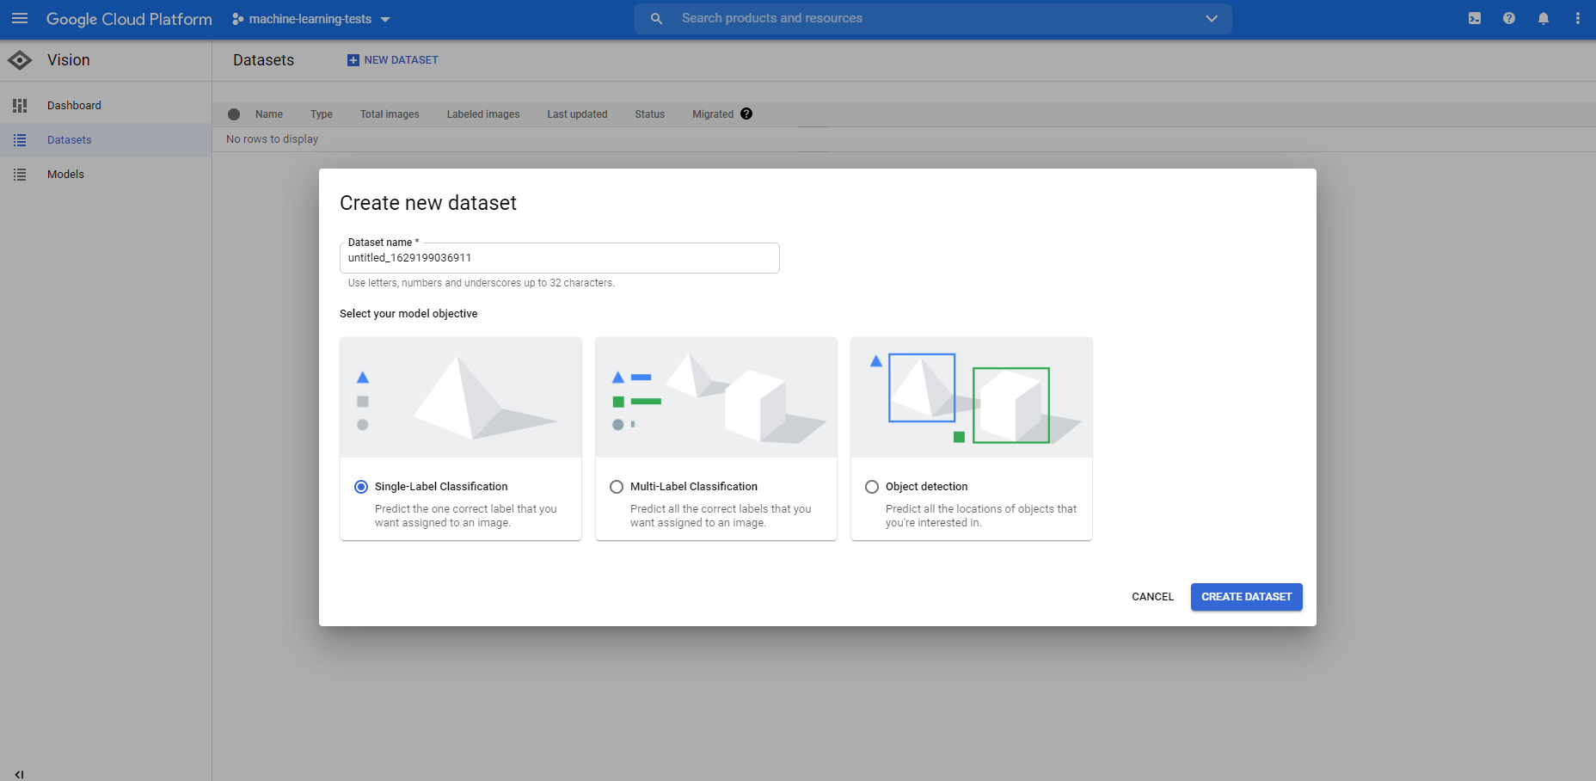
Create the Dataset, easiest to upload directly through the UI then using an existing bucket, bucket has to be in the same region

Slide 12
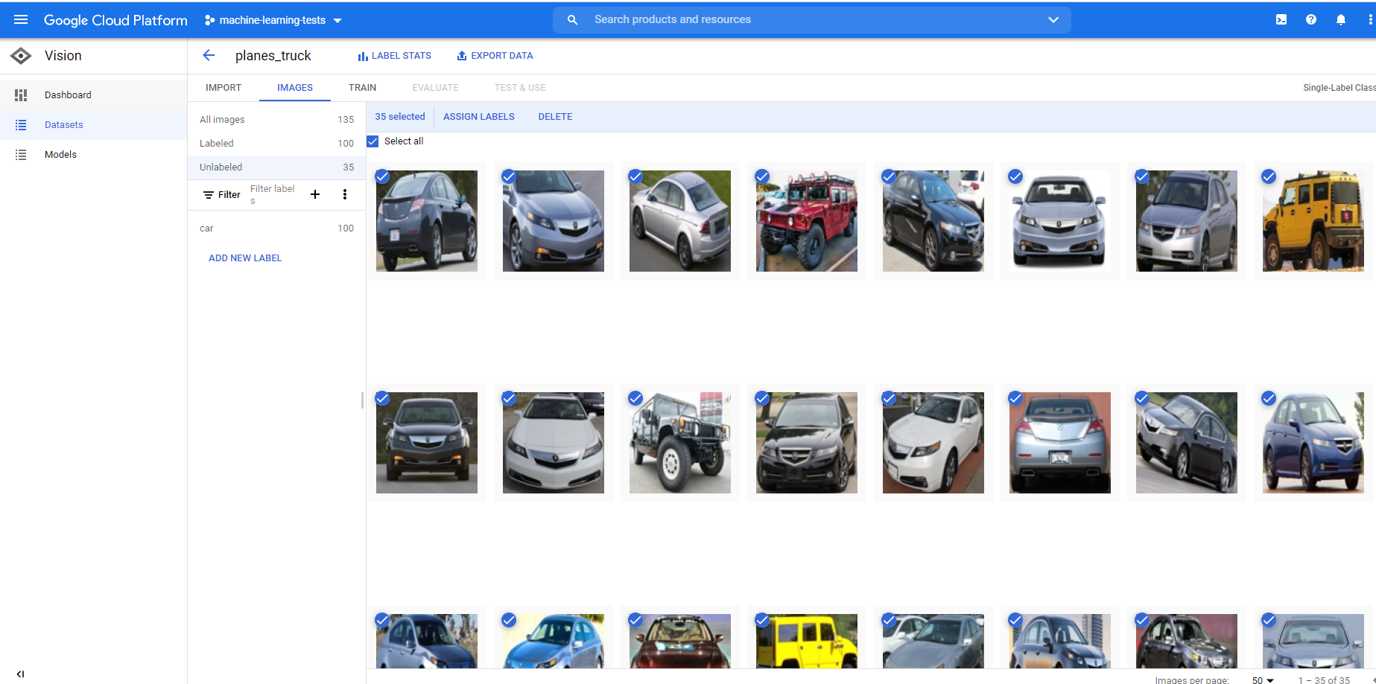
Label Your Data

Slide 13
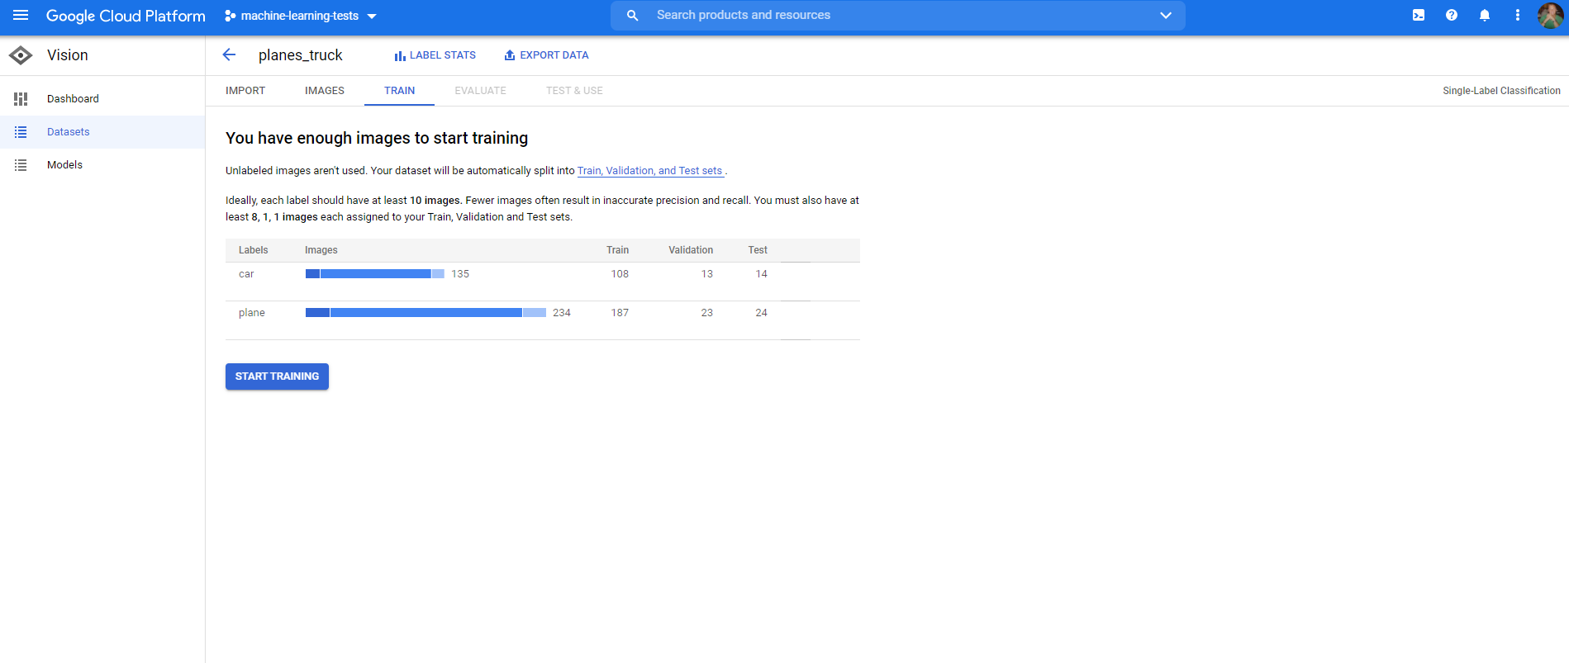
Train, you’ll get an email when complete

Slide 14
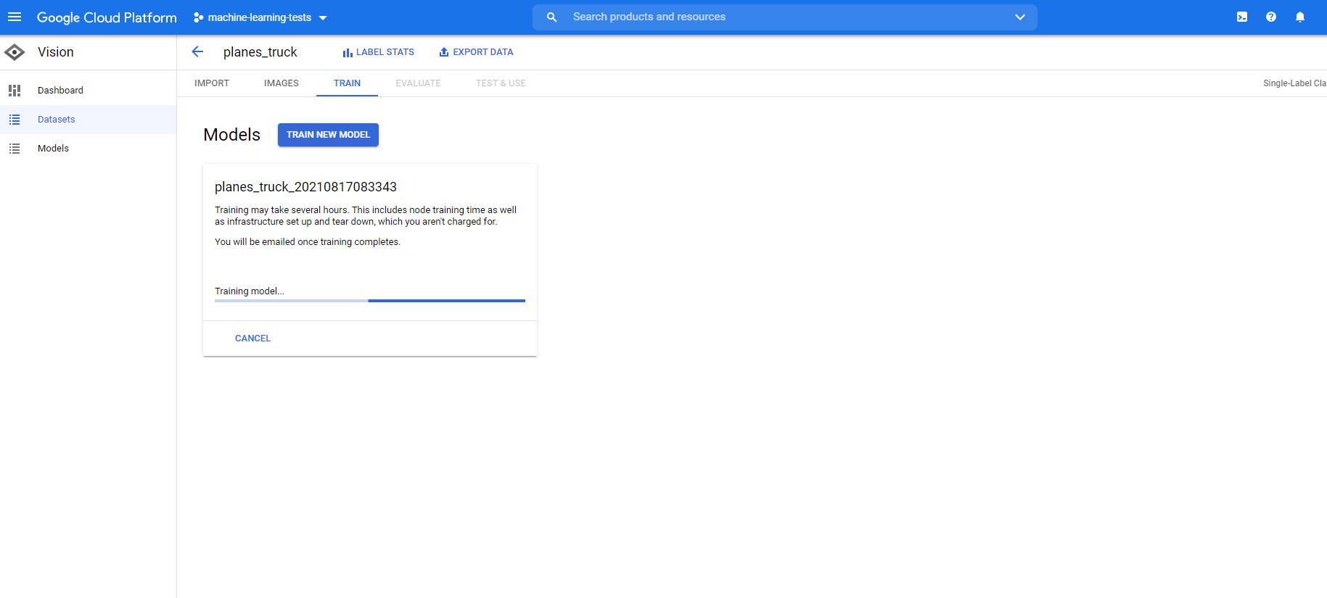
Training screen

Slide 15
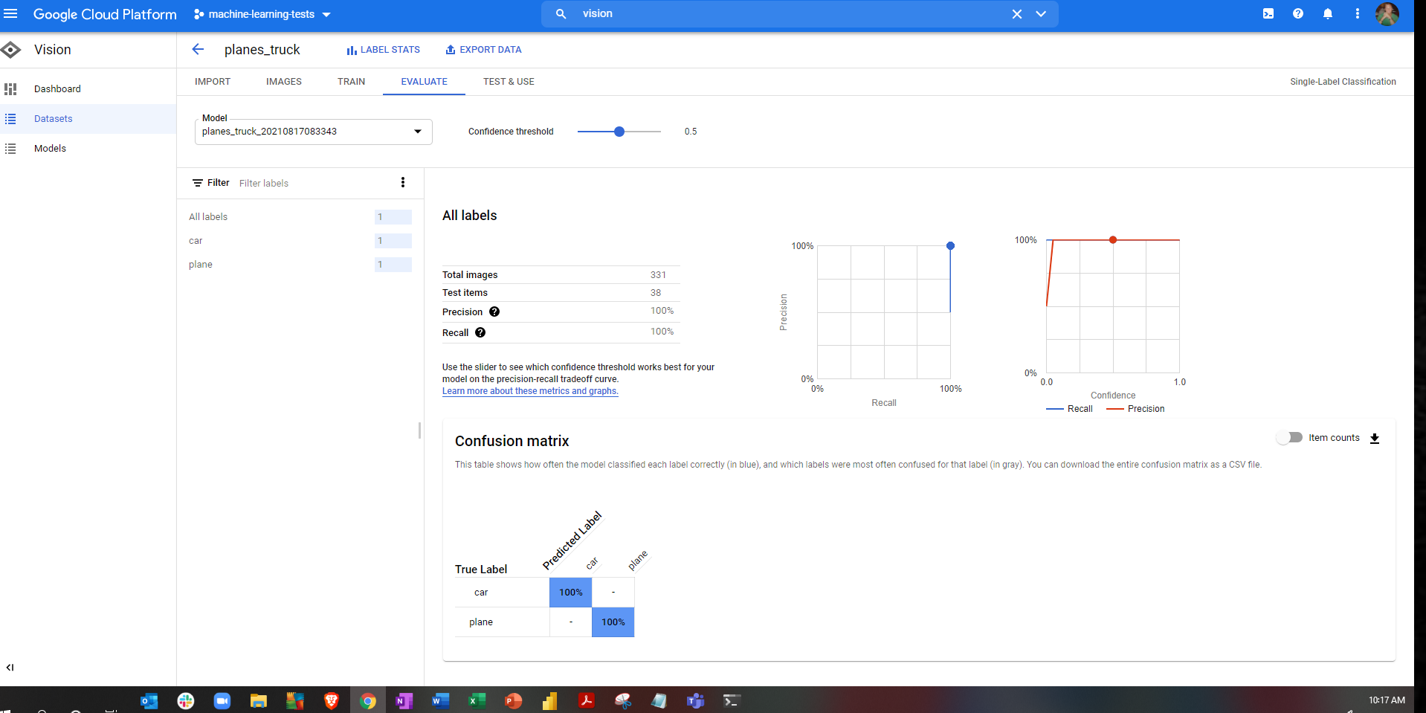
Once Training complete click on evaluate to view results

Slide 16
Azure Advanced Regression

Slide 17
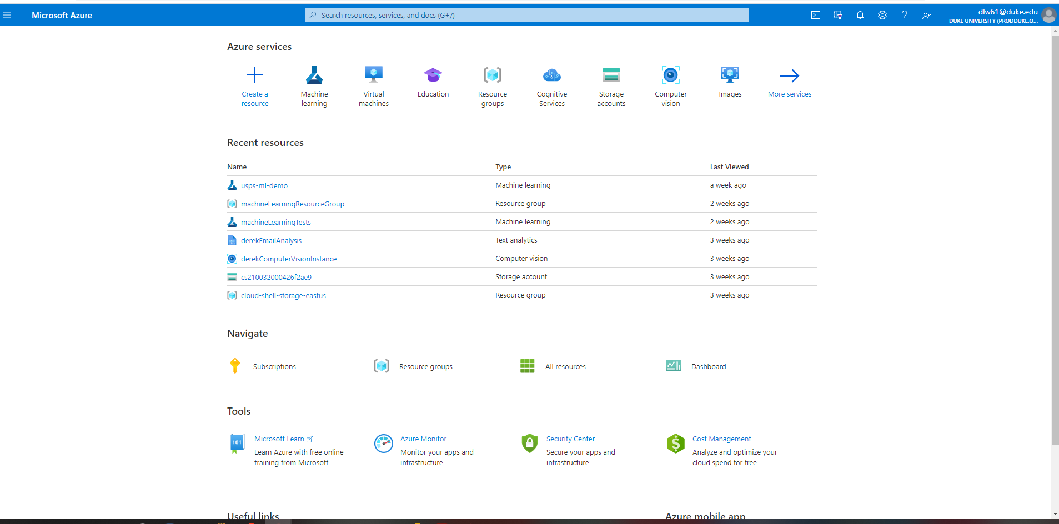
Select or Search Machine Learning

Slide 18
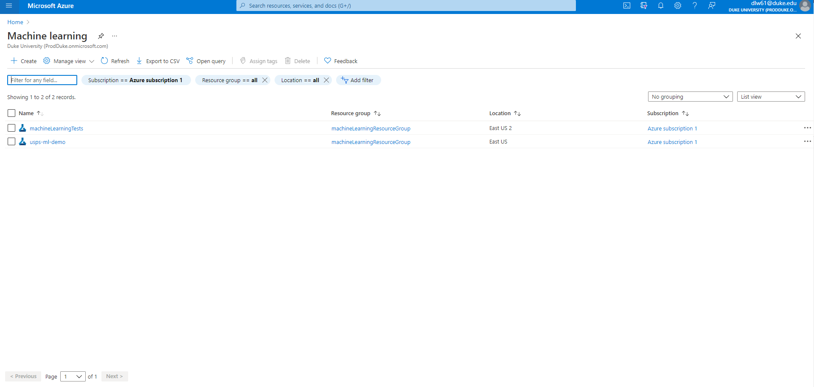
Select Create

Slide 19
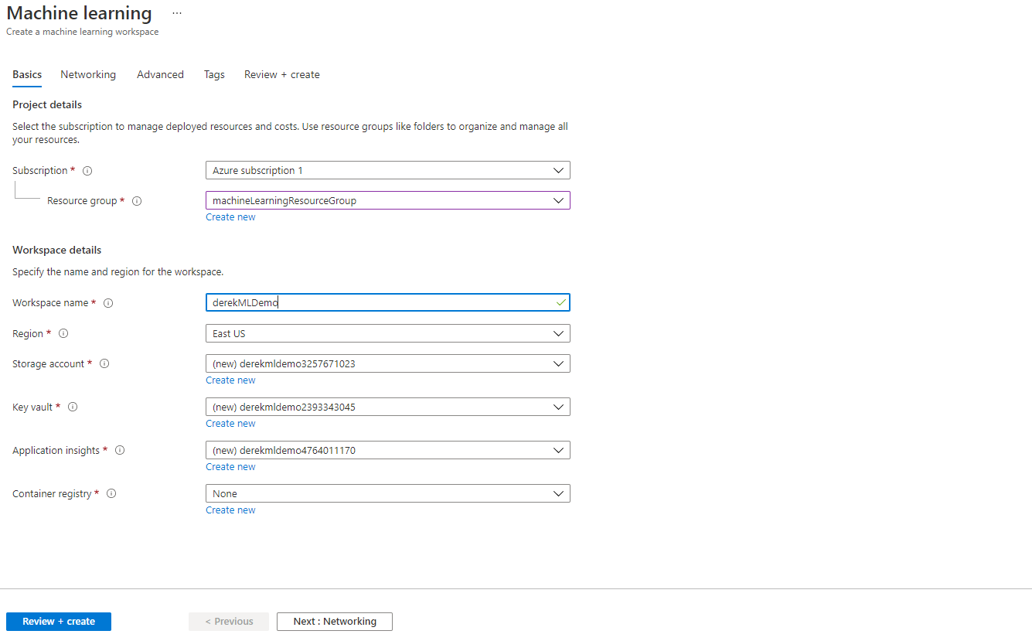
Choose Setting and Create

Slide 20
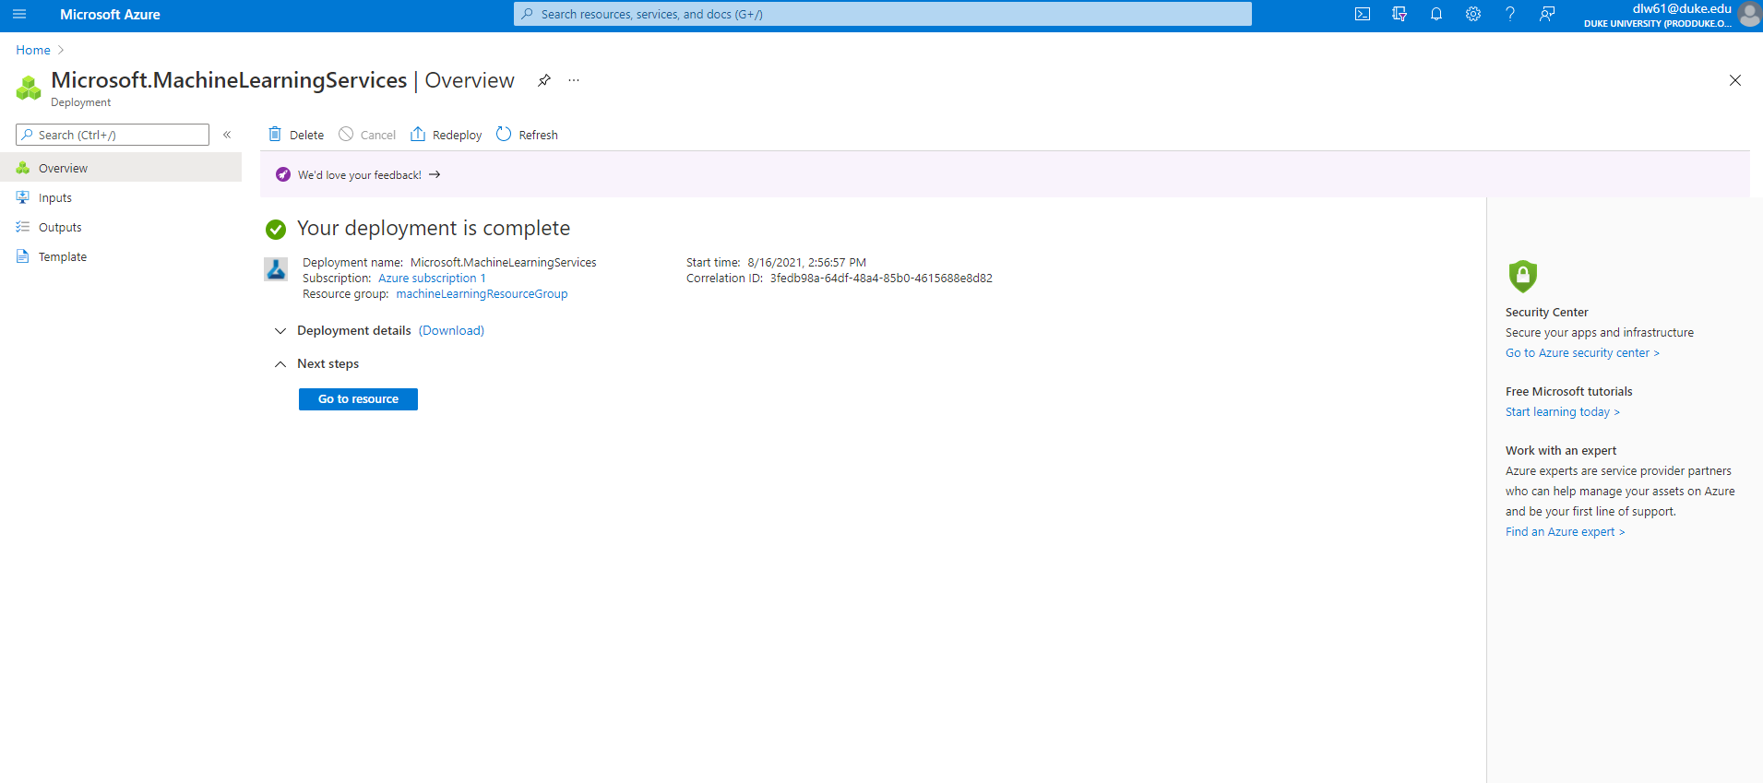
Go to resource and launch studio

Slide 21
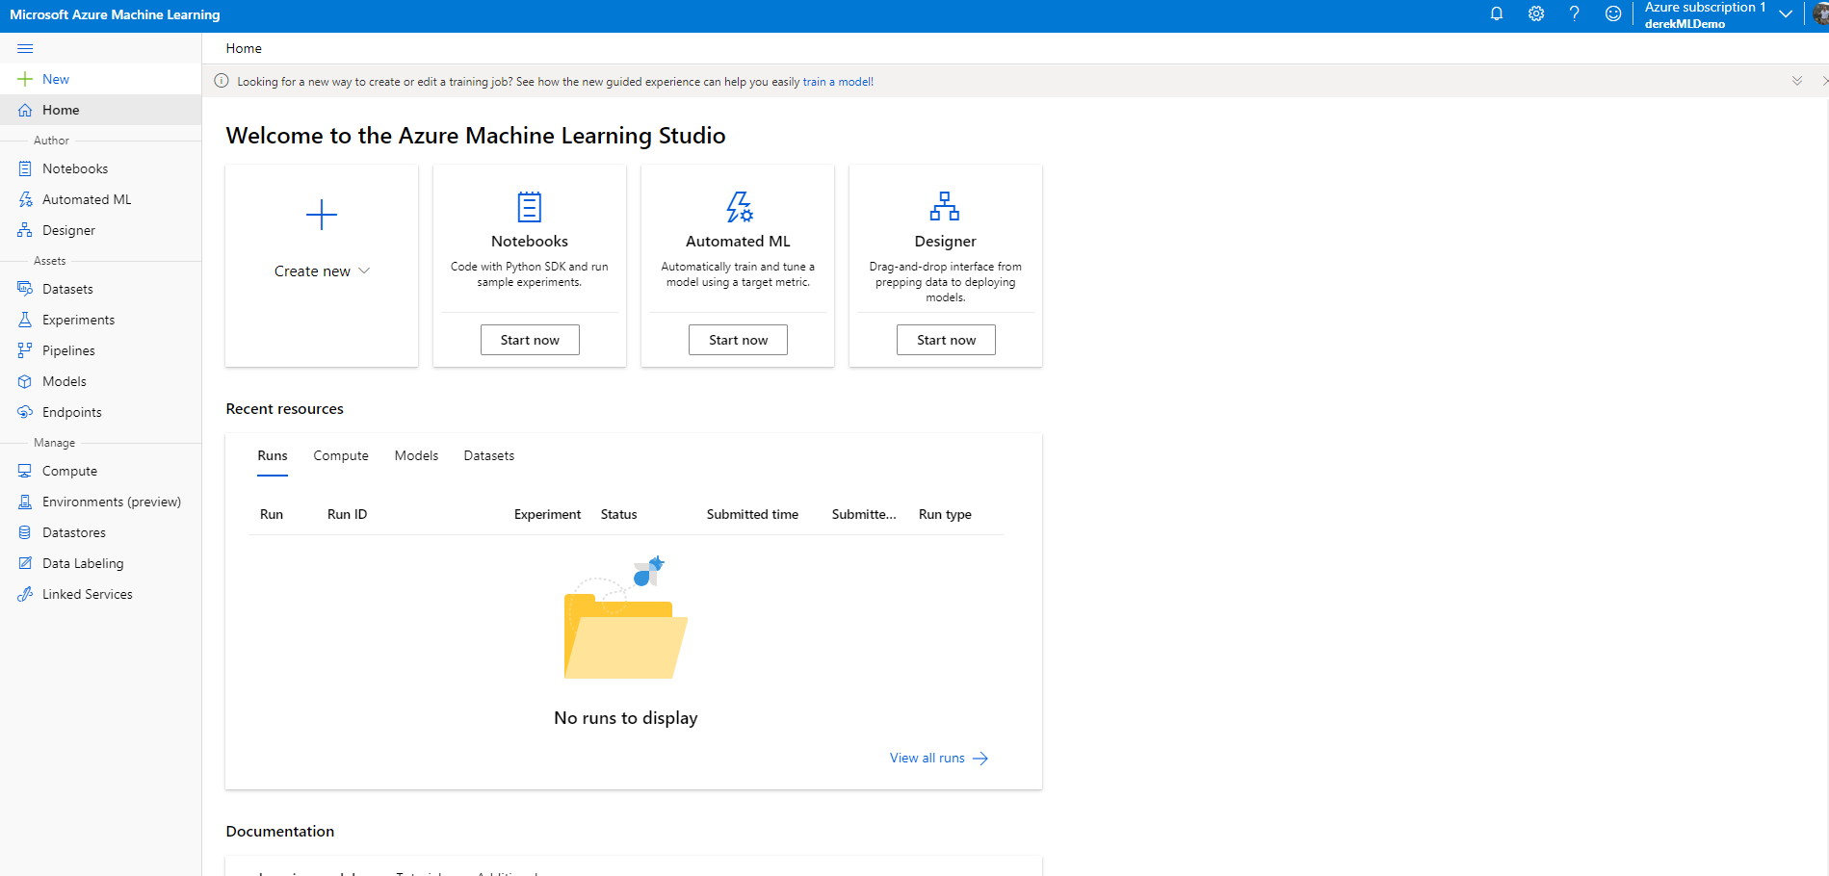
From here you can upload, data, notebooks or use the Auto ML.

Slide 22
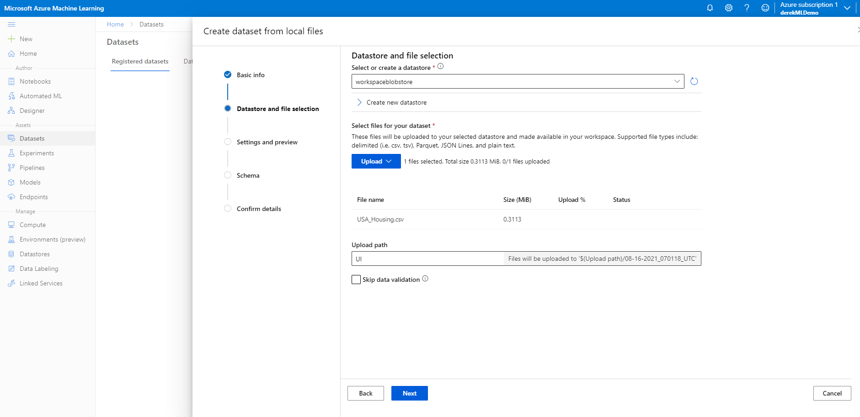
Uploading Data

Slide 23
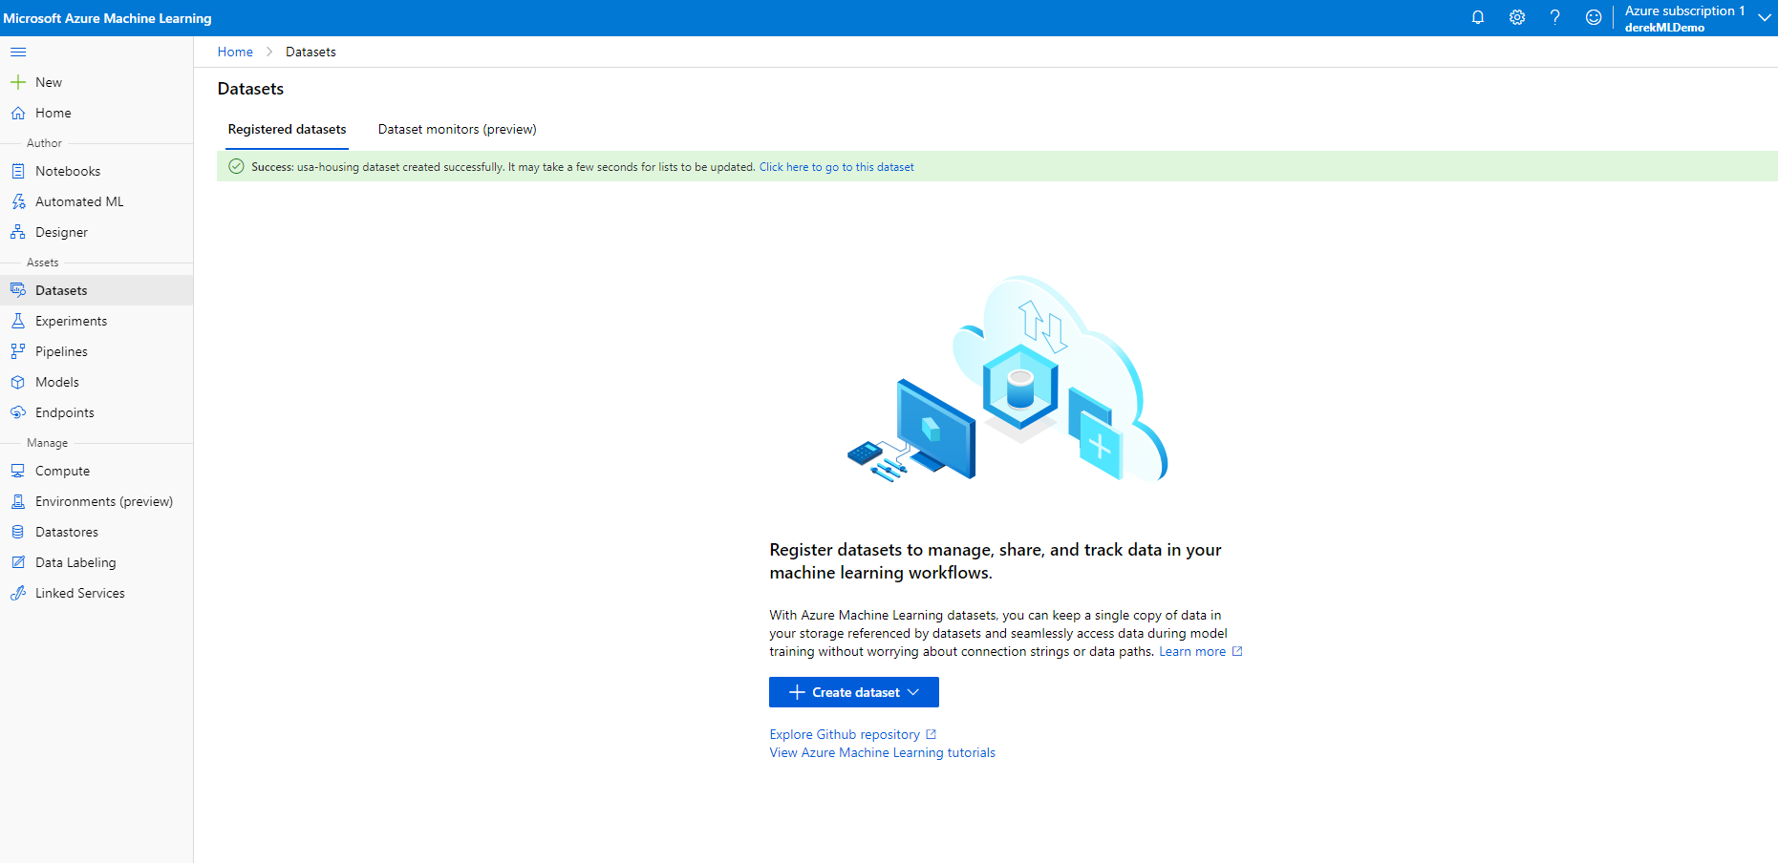
Select Auto ML and follow the steps from the video

Slide 24
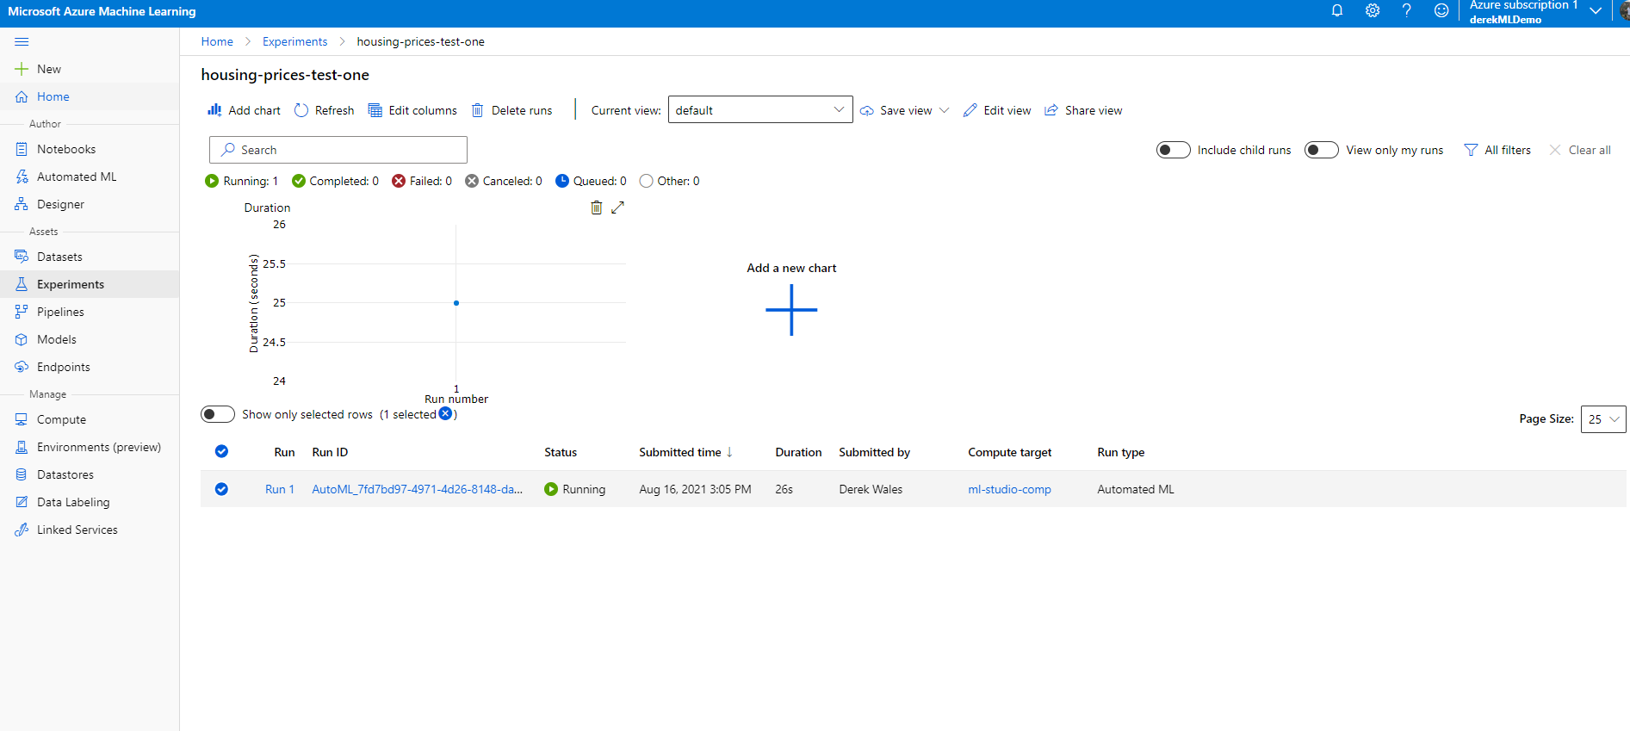
Model Training Screen

Slide 25
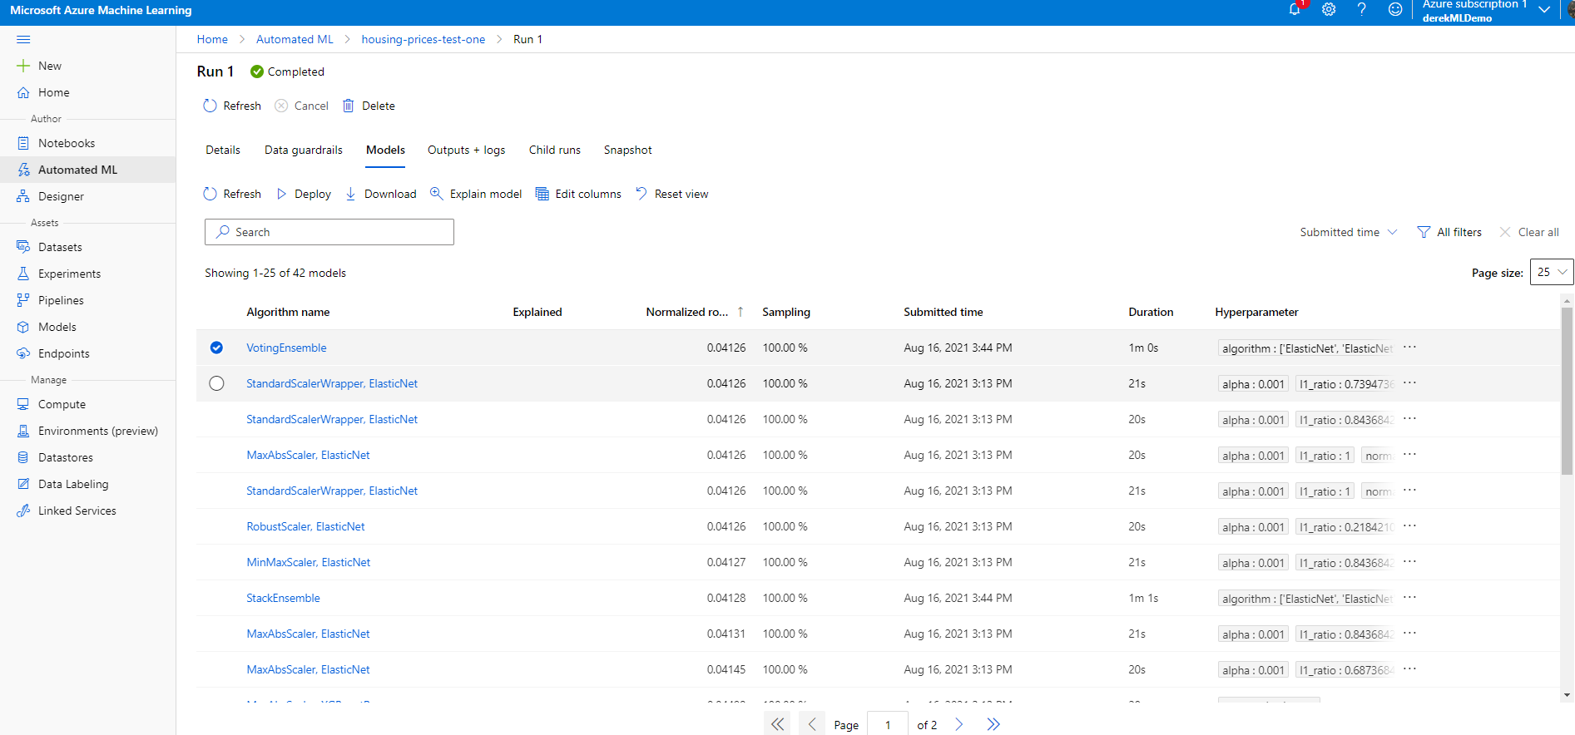
Model Results Screen
Gives you a list of models which can be deployed.

Slide 26
GCP Advanced Regression

Slide 27
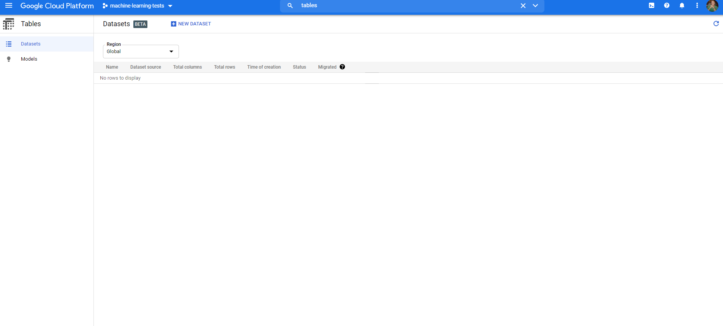
Search for Tables

Slide 28
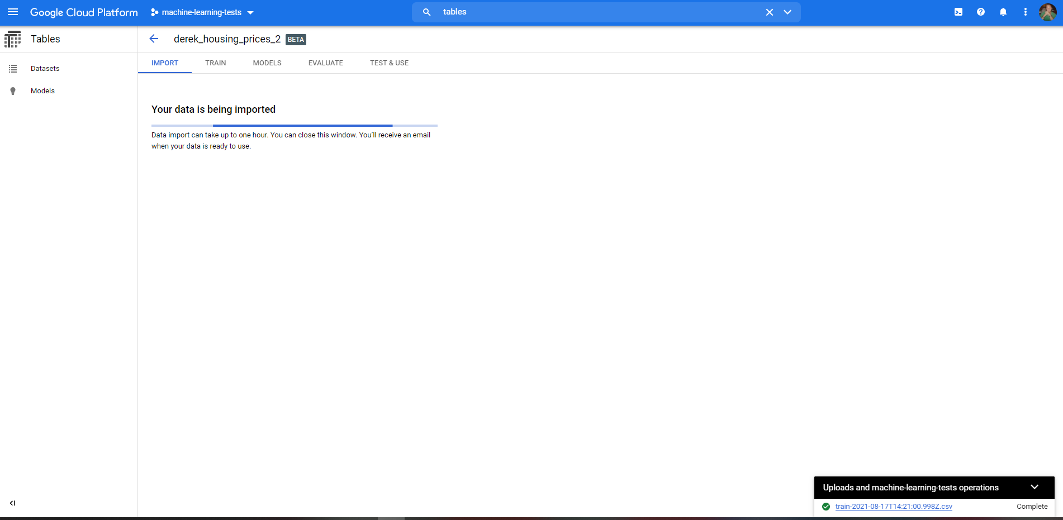
Upload data

Slide 29
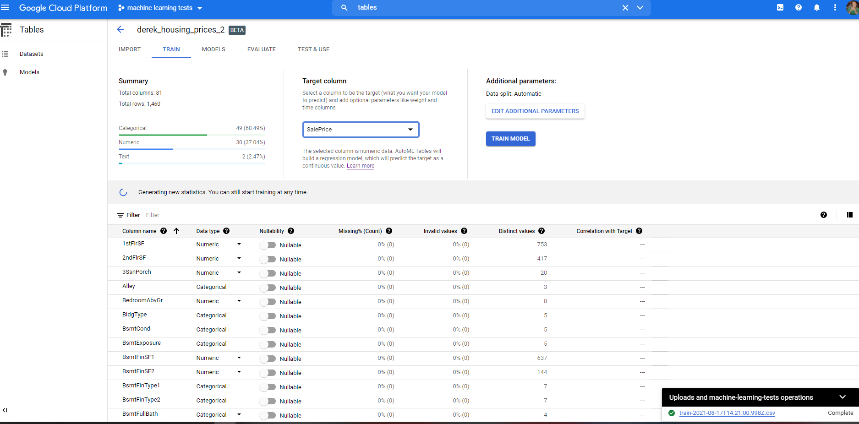
Set target and train

Slide 30
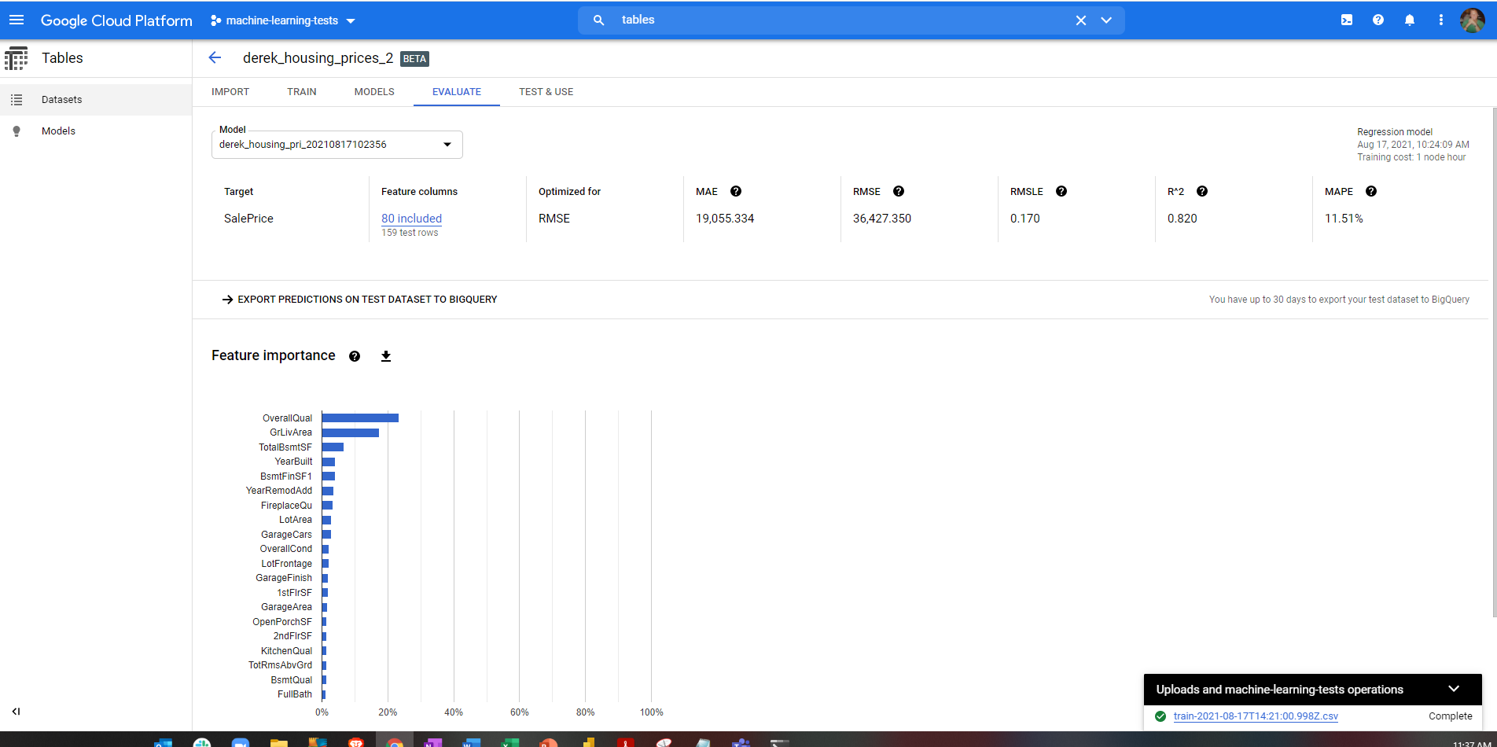
Evaluation Screen

